Slide 1

NATIONAL UNIVERSITY OF MODERN LANGUAGES
Faculty of Engineering and Computing
Department of Software Engineering

Slide 2

SOFTWARE DESIGN AND ARCHITECTURE
LECTURE NO. 4
Introduction to Software Engineering Design
Course Instructor: | Mr. Ahsan Arif
 | Lecturer Department of Software Engineering NUML Islamabad
Date: October 09, 2024
Software Engineering Design: Theory and Practice

Slide 3
LECTURE CONTENTS
  Introduction to Domain Model
    Domain model generation
Date: October 09, 2024
Software Engineering Design: Theory and Practice

Slide 4

INTRODUCTION TO DOMAIN MODEL
What are you going to learn about today?
Domain modeling:
  why?
  what?
  how?
Diagramming domain models
Date: October 09, 2024
Software Engineering Design: Theory and Practice

Slide 5
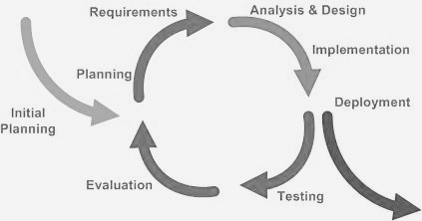
RECALL: ITERATIVE DEVELOPMENT PROCESS
We are here
Date: October 09, 2024
Software Engineering Design: Theory and Practice

Slide 6


Analysis bridges the gap
between requirements and design
Design
Analysis
Requirements
Date: October 09, 2024
Software Engineering Design: Theory and Practice
Notes:
The first efforts focused on unifying three popular modeling methods:
The Booch method, by Grady Booch
The object-oriented software engineering method (OOSE), by Ivar Jacobson
The object modeling technique (OMT) by James Rumbaugh
The UML is a language for
Visualizing
Specifying
Constructing
Documenting

Slide 7
What should we build?
Requirements
But we still don’t fully understand the problem domain!
Analysis
OK, now how should we build this thing?
Design
Date: October 09, 2024
Software Engineering Design: Theory and Practice
Notes:
The first efforts focused on unifying three popular modeling methods:
The Booch method, by Grady Booch
The object-oriented software engineering method (OOSE), by Ivar Jacobson
The object modeling technique (OMT) by James Rumbaugh
The UML is a language for
Visualizing
Specifying
Constructing
Documenting

Slide 8
Domain Model
“Most important—and classic—model in OO analysis” –Larman, p131
Captures entities, attributes, and relationships in the problem domain
Represented with UML class diagram
  Conceptual classes
    As opposed to software or implementation classes
Acts as inspiration for some software classes
  Lowers representational gap
Date: October 09, 2024
Software Engineering Design: Theory and Practice
Notes:
When a concept "acts as inspiration for some software classes," it helps to bridge the gap between the real-world and its software representation, making the software more accurate, understandable, and maintainable.

Slide 9
Domain Modeling:
Why:
Domain modeling helps us to identify the relevant concepts and ideas of a domain.
Guideline:
Domain model should focus on current tasks
Illustrates important concepts in the domain
Created during object-oriented analysis
Decomposes domain into real-world objects or concepts
Identifies conceptual classes
Basis for software design
Date: October 09, 2024
Software Engineering Design: Theory and Practice
Notes:
Essentially advises that you should develop a domain model specifically tailored to the immediate needs or objectives of your project.
In other words, when creating a domain model, you should focus on representing the concepts, entities, and relationships that are directly relevant to the current tasks or goals you're working on.

Slide 10
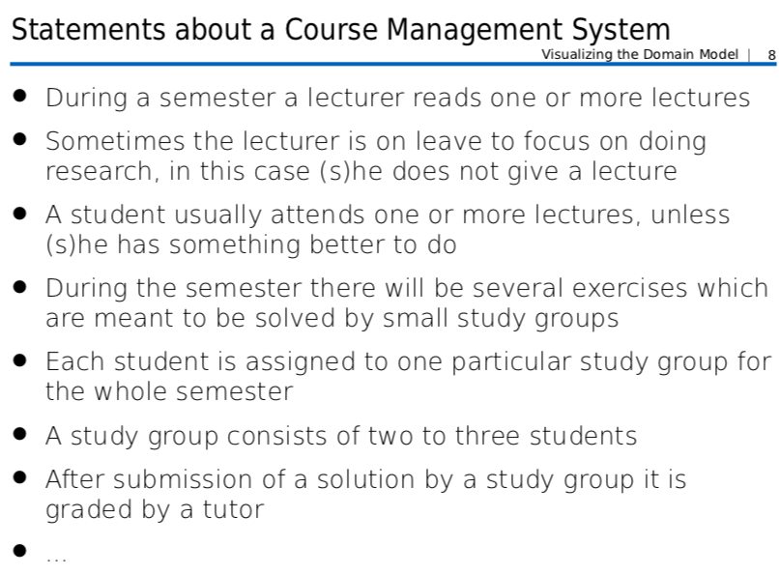
Visualizing Domain Models: By Means of Basic Course Management System:
Date: October 09, 2024
Software Engineering Design: Theory and Practice
Notes:
Essentially advises that you should develop a domain model specifically tailored to the immediate needs or objectives of your project.
In other words, when creating a domain model, you should focus on representing the concepts, entities, and relationships that are directly relevant to the current tasks or goals you're working on.

Slide 11
Conceptual Classes:
Conceptual classes are ideas, things or objects in the domain
To visualize domain models the UML class diagram notation is used.
However, no operations are defined in domain models
Only…
  domain objects and conceptual classes
  associations between them
  attributes of conceptual classes
Date: October 09, 2024
Software Engineering Design: Theory and Practice
Notes:
Essentially advises that you should develop a domain model specifically tailored to the immediate needs or objectives of your project.
In other words, when creating a domain model, you should focus on representing the concepts, entities, and relationships that are directly relevant to the current tasks or goals you're working on.

Slide 12
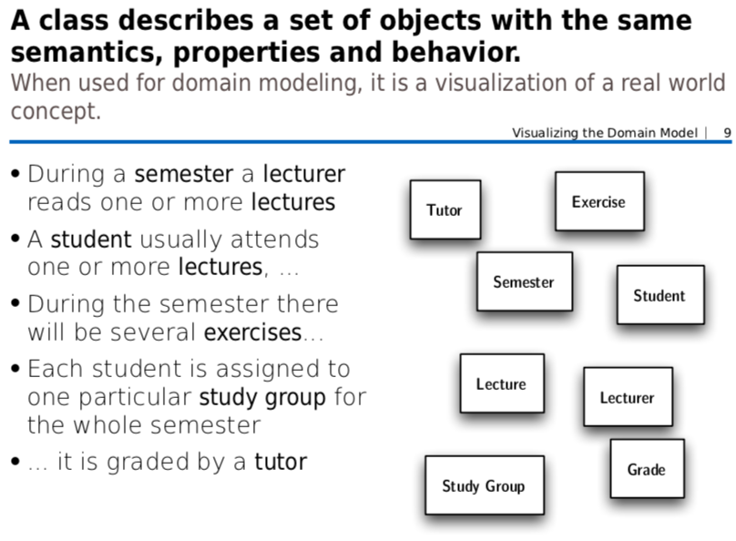
Date: October 09, 2024
Software Engineering Design: Theory and Practice
Notes:
Essentially advises that you should develop a domain model specifically tailored to the immediate needs or objectives of your project.
In other words, when creating a domain model, you should focus on representing the concepts, entities, and relationships that are directly relevant to the current tasks or goals you're working on.

Slide 13
Attributes:
Attributes are logical data values of an object.
It is useful to identify those attributes of conceptual classes that are needed to satisfy the information requirements of the current scenarios under development.
Association:
An association is a relationship between classes.
The ends of an association are called roles.
Roles optionally have a multiplicity, name and navigability.
Date: October 09, 2024
Software Engineering Design: Theory and Practice
Notes:
"Attributes are logical data values of an object" means that attributes are the specific characteristics or properties that define an object. They are the pieces of information that describe the object's state or identity.
For example, if we're talking about a "Book" object, its attributes might include:
title
author
publisher
publication year
ISBN
These attributes are the logical data values that together define a book.
"It is useful to identify those attributes of conceptual classes that are needed to satisfy the information requirements of the current scenarios under development" emphasizes the importance of carefully selecting the attributes for a class. The attributes should be chosen based on the specific information needs of the current project or application.
In other words, you should only include attributes that are relevant and necessary for the tasks at hand. Including too many attributes can make your classes unnecessarily complex and difficult to work with. On the other hand, if you don't include enough attributes, you may not have the information you need to complete your tasks.

Slide 14
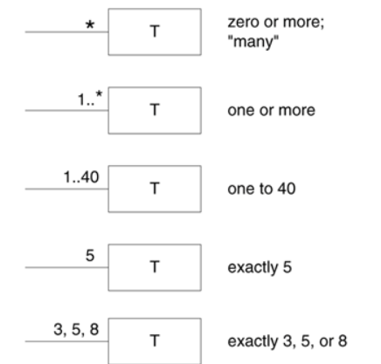
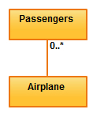
Association - Multiplicity
Is the active logical association when the cardinality of a class in relation to another is being depicted.
For example, one commercial airplane may contain zero to many passengers. The notation 0..* in the diagram means “zero to many
Date: October 09, 2024
Software Engineering Design: Theory and Practice
Notes:
Essentially advises that you should develop a domain model specifically tailored to the immediate needs or objectives of your project.
In other words, when creating a domain model, you should focus on representing the concepts, entities, and relationships that are directly relevant to the current tasks or goals you're working on.

Slide 15
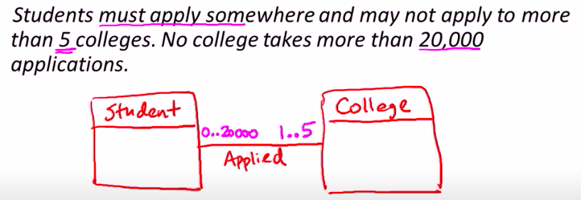
Cardinality/Multiplicity of Association
Date: October 09, 2024
Software Engineering Design: Theory and Practice
Notes:
Essentially advises that you should develop a domain model specifically tailored to the immediate needs or objectives of your project.
In other words, when creating a domain model, you should focus on representing the concepts, entities, and relationships that are directly relevant to the current tasks or goals you're working on.

Slide 16
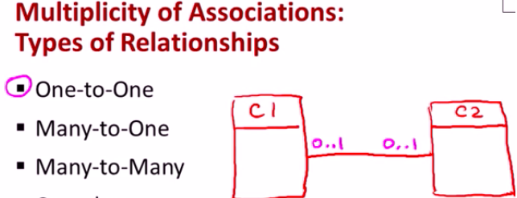
Cardinality/Multiplicity of Association
Date: October 09, 2024
Software Engineering Design: Theory and Practice
Notes:
Essentially advises that you should develop a domain model specifically tailored to the immediate needs or objectives of your project.
In other words, when creating a domain model, you should focus on representing the concepts, entities, and relationships that are directly relevant to the current tasks or goals you're working on.

Slide 17
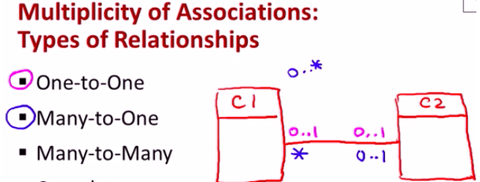
Cardinality/Multiplicity of Association
Date: October 09, 2024
Software Engineering Design: Theory and Practice
Notes:
Essentially advises that you should develop a domain model specifically tailored to the immediate needs or objectives of your project.
In other words, when creating a domain model, you should focus on representing the concepts, entities, and relationships that are directly relevant to the current tasks or goals you're working on.

Slide 18
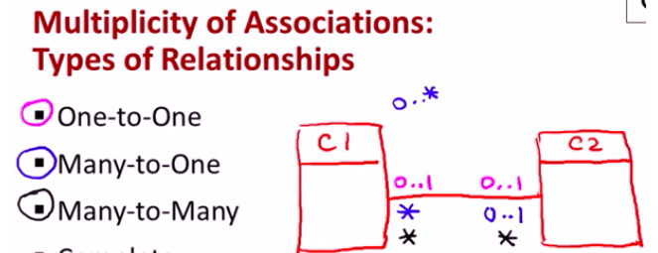
Cardinality/Multiplicity of Association
Date: October 09, 2024
Software Engineering Design: Theory and Practice
Notes:
Essentially advises that you should develop a domain model specifically tailored to the immediate needs or objectives of your project.
In other words, when creating a domain model, you should focus on representing the concepts, entities, and relationships that are directly relevant to the current tasks or goals you're working on.

Slide 19
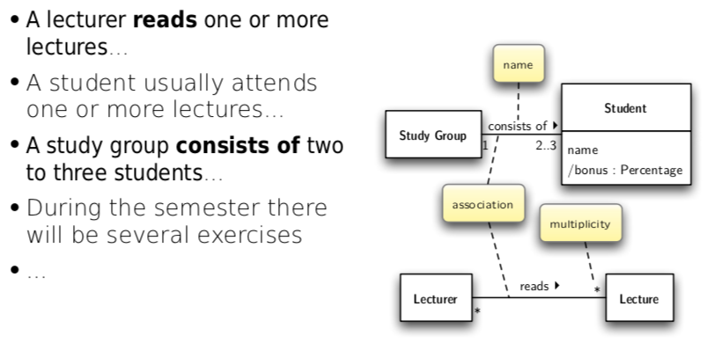
Visualizing Domain Models: By Means of Basic Course Management System:
Date: October 09, 2024
Software Engineering Design: Theory and Practice
Notes:
Essentially advises that you should develop a domain model specifically tailored to the immediate needs or objectives of your project.
In other words, when creating a domain model, you should focus on representing the concepts, entities, and relationships that are directly relevant to the current tasks or goals you're working on.

Slide 20
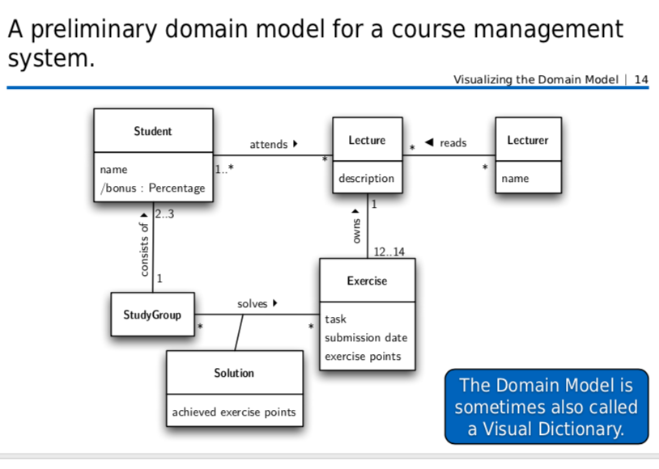
Date: October 09, 2024
Software Engineering Design: Theory and Practice
Notes:
Essentially advises that you should develop a domain model specifically tailored to the immediate needs or objectives of your project.
In other words, when creating a domain model, you should focus on representing the concepts, entities, and relationships that are directly relevant to the current tasks or goals you're working on.

Slide 21
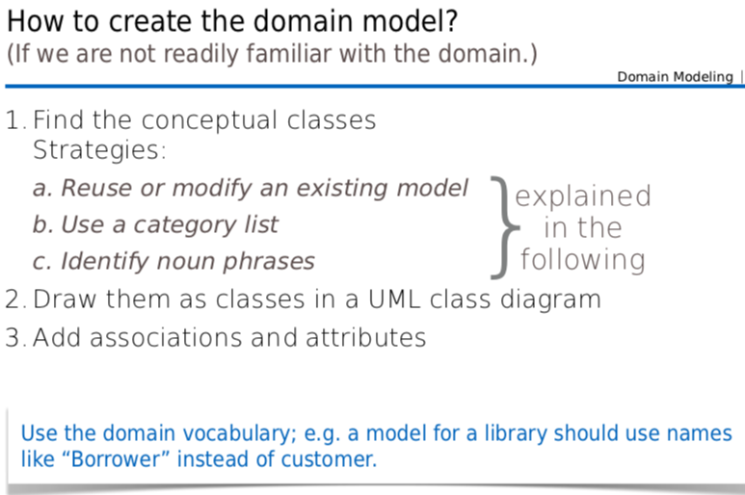
Date: October 09, 2024
Software Engineering Design: Theory and Practice
Notes:
Essentially advises that you should develop a domain model specifically tailored to the immediate needs or objectives of your project.
In other words, when creating a domain model, you should focus on representing the concepts, entities, and relationships that are directly relevant to the current tasks or goals you're working on.

Slide 22
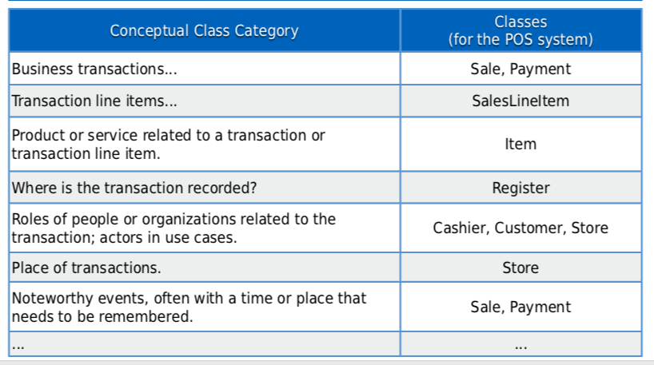
How to create the domain model?
Use a category list to find the conceptual classes
Date: October 09, 2024
Software Engineering Design: Theory and Practice
Notes:
Essentially advises that you should develop a domain model specifically tailored to the immediate needs or objectives of your project.
In other words, when creating a domain model, you should focus on representing the concepts, entities, and relationships that are directly relevant to the current tasks or goals you're working on.

Slide 23
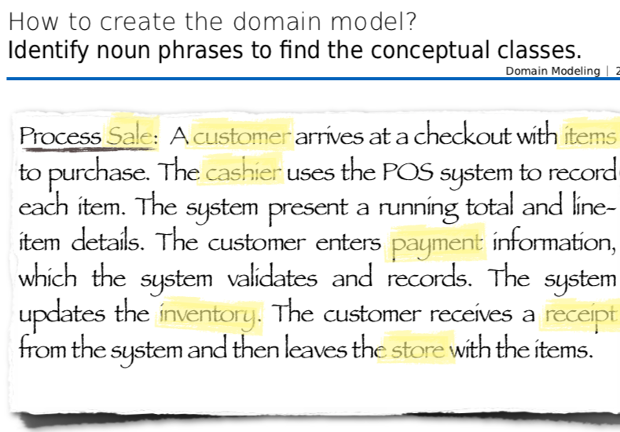
Identify the nouns and noun phrases in textual descriptions of a domain and consider them as candidate conceptual classes or attributes “Use Cases” are also an excellent source for identifying conceptual classes.
Date: October 09, 2024
Software Engineering Design: Theory and Practice
Notes:
Essentially advises that you should develop a domain model specifically tailored to the immediate needs or objectives of your project.
In other words, when creating a domain model, you should focus on representing the concepts, entities, and relationships that are directly relevant to the current tasks or goals you're working on.

Slide 24
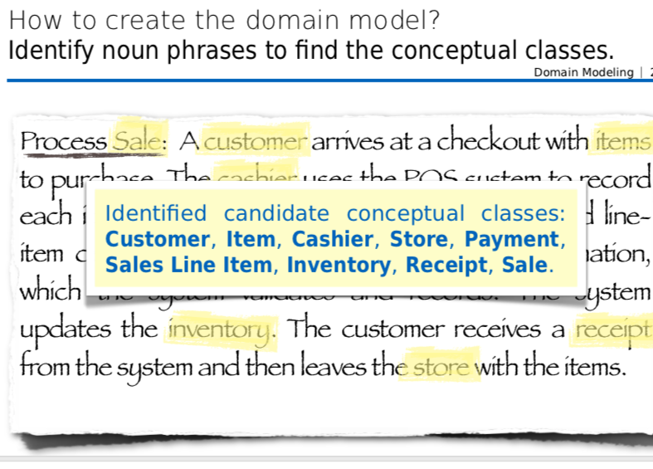
Date: October 09, 2024
Software Engineering Design: Theory and Practice
Notes:
Essentially advises that you should develop a domain model specifically tailored to the immediate needs or objectives of your project.
In other words, when creating a domain model, you should focus on representing the concepts, entities, and relationships that are directly relevant to the current tasks or goals you're working on.

Slide 25
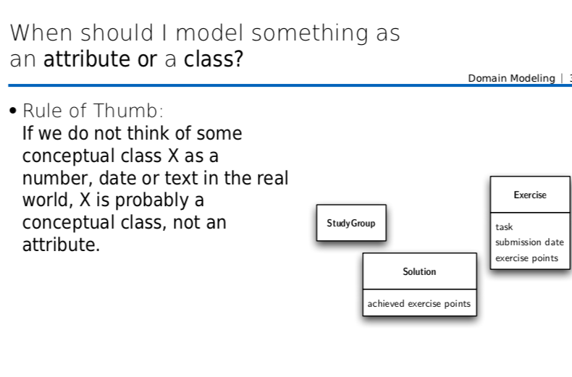
Date: October 09, 2024
Software Engineering Design: Theory and Practice
Notes:
Essentially advises that you should develop a domain model specifically tailored to the immediate needs or objectives of your project.
In other words, when creating a domain model, you should focus on representing the concepts, entities, and relationships that are directly relevant to the current tasks or goals you're working on.
Classes are like categories or types of things (e.g., cars, books, people).
Attributes are like properties of things (e.g., color, title, age).
Think of it this way: A class is a container, and attributes are the things inside the container.

Slide 26
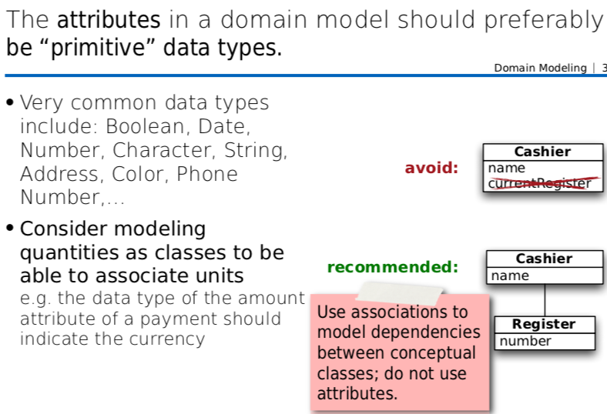
Date: October 09, 2024
Software Engineering Design: Theory and Practice
Notes:
Essentially advises that you should develop a domain model specifically tailored to the immediate needs or objectives of your project.
In other words, when creating a domain model, you should focus on representing the concepts, entities, and relationships that are directly relevant to the current tasks or goals you're working on.

Slide 27

Larman Case Study:
NextGen POS System
POS = Point of Sale
Computerized application used (in part) to record sales and handle payments
Typically used in retail store
  Includes hardware
  E.g. barcode scanner
  Interfaces with various service applications
  E.g. tax calculator
  Must be fault tolerant
  E.g. handle cash as backup
Date: October 09, 2024
Software Engineering Design: Theory and Practice
Notes:
The first efforts focused on unifying three popular modeling methods:
The Booch method, by Grady Booch
The object-oriented software engineering method (OOSE), by Ivar Jacobson
The object modeling technique (OMT) by James Rumbaugh
The UML is a language for
Visualizing
Specifying
Constructing
Documenting

Slide 28
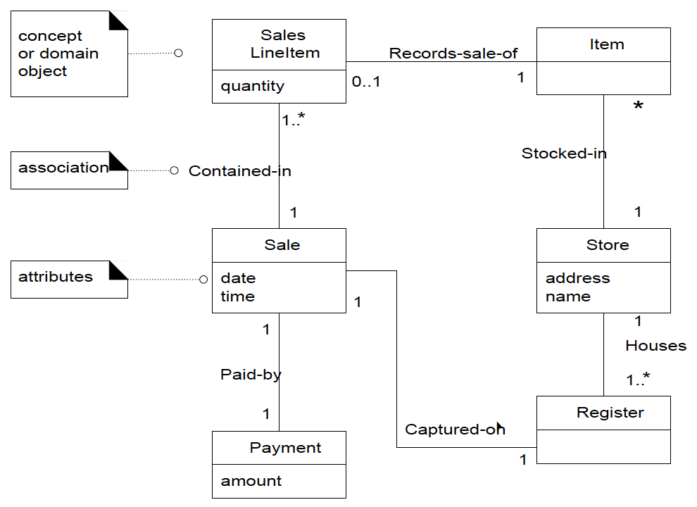
POS Domain Model
Classes: concepts or entities in the problem domain (not software)
Date: October 09, 2024
Software Engineering Design: Theory and Practice
Notes:
The first efforts focused on unifying three popular modeling methods:
The Booch method, by Grady Booch
The object-oriented software engineering method (OOSE), by Ivar Jacobson
The object modeling technique (OMT) by James Rumbaugh
The UML is a language for
Visualizing
Specifying
Constructing
Documenting

Slide 29
POS Domain Model
Classes: concepts or entities in the problem domain (not software)
Attributes: number or text properties of conceptual classes
Date: October 09, 2024
Software Engineering Design: Theory and Practice
Notes:
The first efforts focused on unifying three popular modeling methods:
The Booch method, by Grady Booch
The object-oriented software engineering method (OOSE), by Ivar Jacobson
The object modeling technique (OMT) by James Rumbaugh
The UML is a language for
Visualizing
Specifying
Constructing
Documenting

Slide 30
POS Domain Model
Classes: concepts or entities in the problem domain (not software)
Attributes: number or text properties of conceptual classes
Associations: relationships
between classes
Date: October 09, 2024
Software Engineering Design: Theory and Practice
Notes:
The first efforts focused on unifying three popular modeling methods:
The Booch method, by Grady Booch
The object-oriented software engineering method (OOSE), by Ivar Jacobson
The object modeling technique (OMT) by James Rumbaugh
The UML is a language for
Visualizing
Specifying
Constructing
Documenting

Slide 31
Thank You...
Mr. Ahsan Arif
Lecturer (Dept. of Software Engineering)
ahsanarif.se42@gmail.com

